Slide 1

PROJECT GROUP 01
TEAM MEMBERS
Girish Krishnagouda Patil.
M Rakesh Kumar.
Ashish Kumar.
Krishna Rathod.
Nithesh S Shetty.
Gunguru Jairus Kumar.
Miss Shweta Anil Pawar.
Karrolla Shailaja.

Slide 2

AVIATION
Flight Delay Analysis
DATA SET PROPERTIES
KPI’s
Domain : Aviation
Project Name: Flight Delay Analysis
Dataset Name: airlines, airports, flights
Dataset Type: CSV Data
Dataset Size: Total 10 lakhs +
Weekday Vs Weekend total flights statistics
Total number of cancelled flights for JetBlue Airways on first date of every month
Week wise, State wise and City wise statistics of delay of flights with airline details
Number of airlines with No departure/arrival delay with distance covered between 2500 and 3000

Slide 3
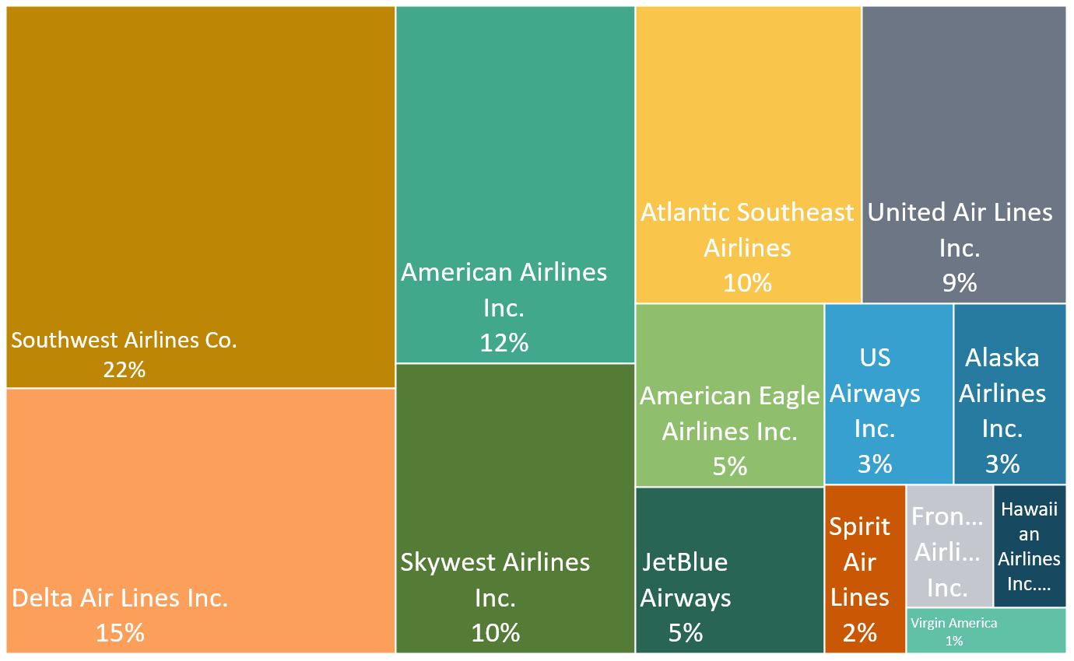
AVIATION
AIRLINES SUMMARY.
FLIGHTS PERCENTAGE BY AIRLINES
Southwest airlines has highest no of flights among all the airlines, Followed by Delta airlines(15%) and American airlines(12%).
SOUTHWEST AIRLINES
22%
Virgin America
Virgin America airlines has lowest no of flights followed by Hawaiian airlines and Frontier Airlines
1%

Slide 4



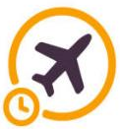
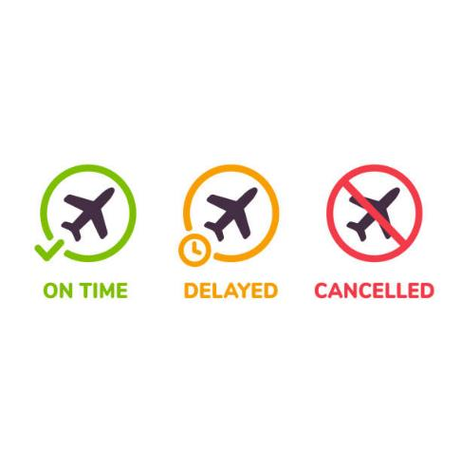
AVIATION
FLIGHTS SUMMARY
TOTAL NO OF FLIGHTS
AIRLINE WISE AVG DEPARTURE AND ARRIVAL DELAY
5819079
FLIGHTS CANCELLED
89884
DIVERTED FLIGHTS
15187
AVG DEPARTURE DELAY
INSIGHTS
9.37
Sprit airlines has highest arrival(14.47) as well as departure(15.94) delay.
Alaska airlines is on time or before time, followed by Delta airlines(0.19) which has lesser delay on arrival where as Hawaili airlines has lowest departure delay(0.49)
AVG ARRIVAL DELAY
4.41

Slide 5

AVIATION
Weekday Vs Weekend total flights statistics
WEEKDAY VS WEEKEND TOTAL FLIGHTS BY PERCENTAGE
20%
26.09% Flights are running on weekends .
73.91% Flights are running on weekdays
FLIGHTS % BY WEEKDAYS.
SOUTHWEST AIRLINES HAS HIGHEST NO OF FLIGHTS DURING WEEKDAYS AS WELL AS WEEKENDS FOLLOWED BY DELTA AIRLINES AND AMERICAN AIRLINES.
NO OF FLIGHTS ARE LESSER IN WEEKENDS WHEN COMPARED WITH WEEKDAYS
VIRGIN AIRLINES HAS LOWEST NO OF FLIGHTS DURING WEEKDAYS AS WELL AS WEEKENDS FOLLOWED BY HAWAIIAN AIRLINES AND FRONTIER AIRLINES.

Slide 6
Number of cancelled flights on first date of every month
Analysis of Airline wise cancelled flights on first date of every month
66%
Due to reason B 66% of the Flights are cancelled on 1st of every month
17%
JETBLUE AIRWAYS
SOUTHWEST AIRLINES
HAWAIIAN AIRLINES.
Due to reason C and A 66% of the Flights are cancelled on 1st of every month
135(2.54%)
1150(21.6%)
7(0.13%)
IT IS 7TH LOWEST CANCELLED FLIGHTS AMONG ALL THE AIRLINES
IT HAS HIGHEST CANCELLED FLIGHTS AMONG ALL THE AIRLINES, FOLLOWED BY AMERICAN EAGLE AIRLINES WHICH HAS 2ND HIGHEST CANCELLED FLIGHTS
IT HAS LOWEST FLIGHT CANCELLATION FOLLOWED BY ALASKA AIRLINES AND FRONTIER AIRLINES .
0%
No flights were cancelled due to reason D.

Slide 7
ANALYSIS OF AVERAGE FLIGHTS DELAY
WEEKWISE
WEEK WISE STATISTICS OF DELAY OF FLIGHTS WITH AIRLINE DETAILS
Spirit Air Lines has average highest arrival delay, Followed by Frontier Airlines(12.49) .
SPIRIT AIR LINES
 | DAYS OF THE WEEK
AIRLINES | 1 | 2 | 3 | 4 | 5 | 6 | 7 | Average
Atlantic Southeast Airlines | 9.00 | 6.95 | 6.96 | 7.82 | 5.70 | 2.85 | 5.83 | 6.45
American Eagle Airlines Inc. | 10.17 | 4.94 | 5.62 | 6.91 | 7.94 | 1.98 | 6.83 | 6.34
Alaska Airlines Inc. | -0.25 | -1.80 | -1.72 | -0.45 | 0.42 | -2.73 | -0.46 | -1.00
American Airlines Inc. | 5.09 | 1.23 | 2.56 | 4.87 | 4.83 | 1.93 | 3.38 | 3.41
Delta Air Lines Inc. | 1.34 | 0.69 | 0.05 | 2.33 | 0.16 | -2.46 | -1.54 | 0.08
Frontier Airlines Inc. | 15.33 | 12.50 | 12.50 | 11.74 | 12.12 | 11.27 | 11.96 | 12.49
Hawaiian Airlines Inc. | 1.92 | -0.30 | 1.42 | 2.89 | 4.90 | 1.85 | 1.17 | 1.98
JetBlue Airways | 8.41 | 8.37 | 4.96 | 9.28 | 5.91 | 3.01 | 6.52 | 6.64
Skywest Airlines Inc. | 7.86 | 5.93 | 5.78 | 6.05 | 5.64 | 3.17 | 6.02 | 5.78
Southwest Airlines Co. | 5.09 | 4.17 | 3.67 | 5.78 | 5.24 | 2.22 | 4.01 | 4.31
Spirit Air Lines | 17.71 | 14.17 | 12.45 | 13.84 | 14.77 | 13.16 | 15.21 | 14.47
United Air Lines Inc. | 7.46 | 6.54 | 5.46 | 6.76 | 4.81 | 2.05 | 3.98 | 5.29
US Airways Inc. | 5.08 | 4.44 | 1.56 | 4.53 | 4.43 | 1.37 | 4.11 | 3.65
Virgin America | 6.73 | 3.20 | 0.44 | 6.84 | 6.77 | -1.65 | 9.51 | 4.55
14.47
Alaska Airlines are on time throughout the week, followed by Delta Airlines (0.08) and Hawaiian Airlines(1.98)
Alaska Airlines
-1.00
OVERALL AVERAGE DELAY THROUGHOUT THE WEEK

Slide 8
ANALYSIS OF AVERAGE FLIGHTS DELAY
CITY WISE
TOP 10 CITIES WITH HIGHEST ARRIVAL DELAY
ST CLOUD
St Cloud has maximum arrival delay followed by Trenton and Agena
23.026
Vernal has no delay followed by Moab and Iron Mountain, in fact the flights are before the time..!!
VERNAL
TOP 10 CITIES WITHOUT ARRIVAL DELAY
-13.761
AVERAGE FLIGHT DELAY
Flight delay ranges between -13.761 to 23.026
4.407

Slide 9
ANALYSIS OF FLIGHTS WITH NO DELAY
DISTANCE COVERED BETWEEN 2500 AND 3000
AIRLINES WITH NO DEPARTURE/ARRIVAL DELAY WITH DISTANCE COVERED BETWEEN 2500 AND 3000
NO DELAY
8 Airlines are there with no departure /arrival delay
8
UNITED AIRLINES
United airlines have highest no if flights with no departure /arrival delay
26849
US AIRWAYS
US Airways have lowest no of flights with no departure/arrival delay
3983

Slide 10
THANK YOU

